Slide 1
Small Business Ideas
Multi-Purpose Cart

Slide 2
Goal of the Small Business Group
Because wheelchair users have many hindrances in finding employment, our goal is to design a product that aids disabled users in running their own small businesses.
By enabling its user to gain more independence and self-sufficiency through earning an income and feel less burdensome to his or her family…

Slide 3
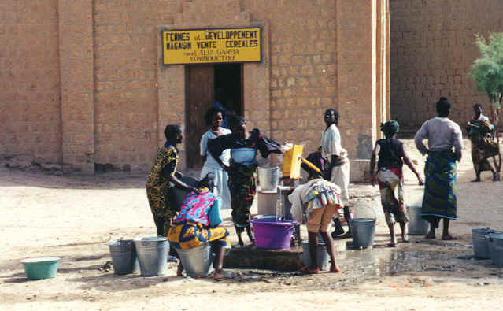
Identified Market: Water Supply
In many places in Tanzania*, water is not easily accessible or available.
Even in cities, people may travel a few miles to the nearest tap to purchase water
The purchased water must also be boiled before it is safe to drink
People are willing to purchase water for a higher price if it has come from farther away!
At a local water tap.

Slide 4
Problem: Water Transport.
How much water does a person need each day?
One adult will drink 2 ~ 3 L /day minimum. (Children can have less?)
At least one jerrican (20 L) per small family (4 people), per day.
How and where do people get water?
Terrain and distance to water source vary according to location (urban v. rural.)
Looking at a relatively flat, city-environment, (e.g.. Dar Es Salaam)…
Each day, a member of the family will have the responsibility for walking (on average) 2 km to a local water pump. The people that regulate the water pump will charge about ?? to fill up a 20 L jerrican. Water is then carried back home by hand.

Slide 5
How much time and money is spent on water acquisition?
Considerations:
Distance between home and water source. Difference between walking 2 km of flat, smooth terrain, and 2 km uphill.
2) Water availability. During water shortages, there can be a long wait (~1/2 day) at the water dispenser to receive water.
3) Who collects the water for the family. Retrieving water is often a job done by children. Depending on the age and strength, the task of carrying one 20 L ‘jerrican’ of water can be quite arduous.
Water weighs 8 1/3 lbs per gallon.
So, one jerrican (20L) filled with water weighs 20 kg, or about 44 lbs!!

Slide 6
Task: To design a means for wheelchair users to transport water.
Tricycles have been spotted transporting water in Dar Es Salaam! They can accommodate up to two standard jerricans.
But, as of now… wheelchairs are not equipped with storage compartments.
PICTURE HERE. At least of a jerrican next to a person so people can see its scale.

Slide 7
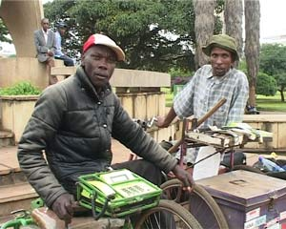
Identified Market: Call Vendor
People commonly do not own their own phone, but pay to use a phone on a per-call basis.
TTCL phones are able to run off of batteries. They use a pre-paid service.
Call vendors sit in busy areas where people know where to find them.
Using an attached tray to hold a TTCL phone to his wheelchair, this disabled man is able to earn an income.

Slide 8
Functional Requirements
Must be:
produced locally
affordable
easily moveable and transformable (able to be manipulated by the wheelchair user without assistance.)
able to safely transport at least *two 20 L jerricans of water (~ 90 lbs)
versatile- to accommodate multiple functions and carrying loads.

Slide 9
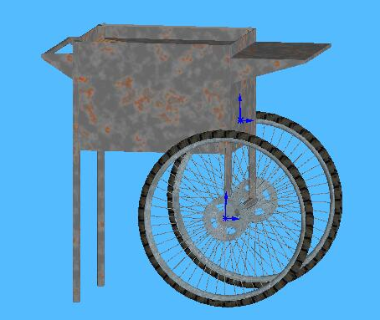
Proposed Solution: Multi-Purpose Cart
We propose this detachable cart unit that can be used for multiple small business enterprises as well as for transporting water.
Versatility of function:
  lets the user select the type of small business he or she desires and is able to perform.
  User can easily switch between businesses (e.g. collect water and sell vegetables)
  Cart can be placed in front of merchant and function as a sales stand. (store front, desk...)
  Mount for a TTCL phone
A simple hitch enables the cart to detach from the wheelchair and be self-supported.

